Slide 1
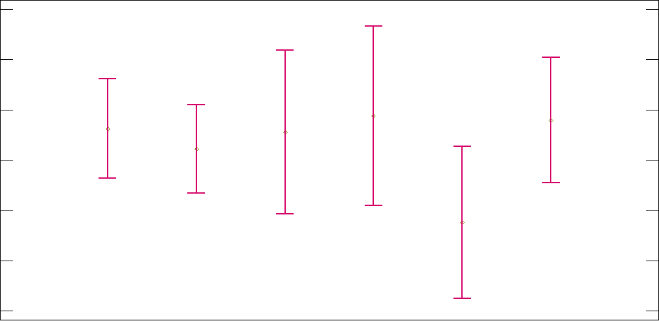

Interactions & 95% of LSD Intervals
2
Unfavorable
1,95
Favorable
1,9
Very
Favorable
1,85
$$\sqrt[4]{YearsCode}$$
1,8
Indifferent
Very Unfavorable
Unsure
1,75
1,7
Blockchain

